Slide 1
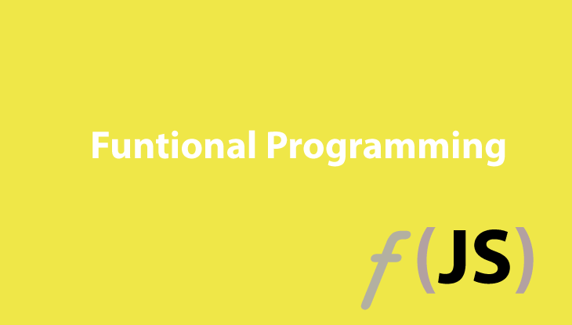

Slide 2
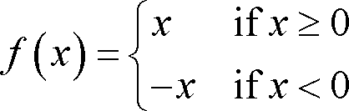
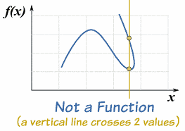
Functional ?

Slide 3
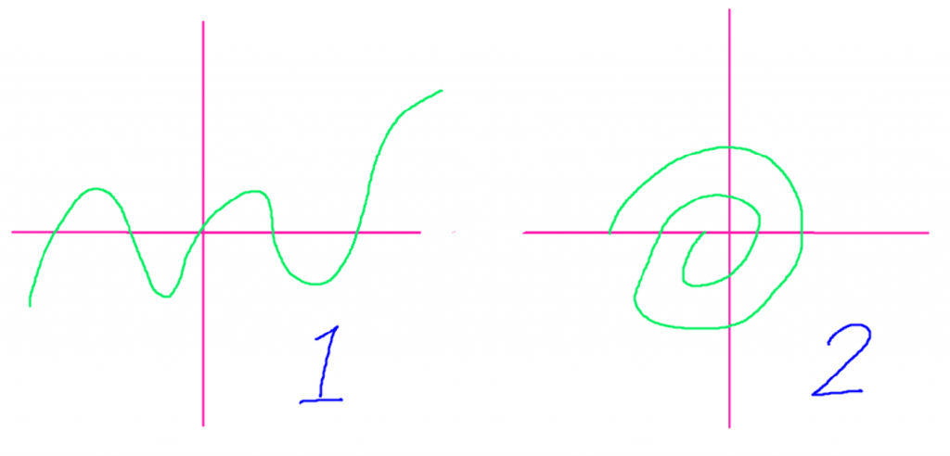
Functional ?

Slide 4
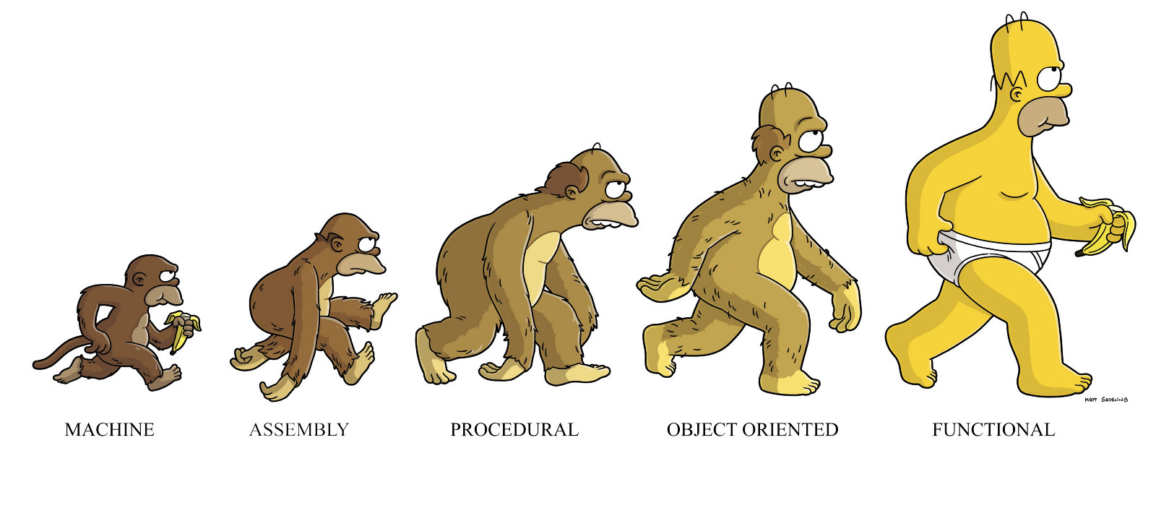

Functional Programming ?
Functional programming (often abbreviated FP) is the process of building software by composing pure functions, avoiding shared state, mutable data, and side-effects. Contrast with object oriented programming, where application state is usually shared with methods in objects.

Slide 5
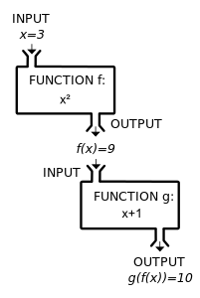
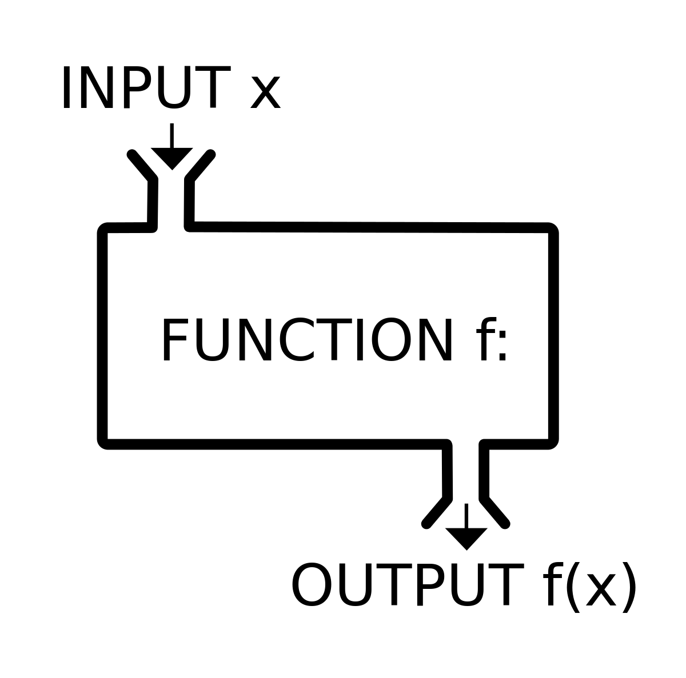
Functional Programming ?

Slide 6
Functional Programming ?
Functional programming (often abbreviated FP) is the process of building software by composing pure functions, avoiding shared state, mutable data, and side-effects. Contrast with object oriented programming, where application state is usually shared with methods in objects.

Slide 7
OO VS Functional
Encapsulation Abstraction Inheritance Polymorphism
Pure Function First Class Function Immutable Data Referential Transparency

Slide 8
Pure Function
The function always returns the same result if the same arguments are passed in. It does not depend on any state, or data, change during a program’s execution. It must only depend on its input arguments.
The function does not produce any observable side effects such as network requests, input and output devices, or data mutation.
function add(a, b){
return a + b;
}

Slide 9
First-Class Function
A language with first-class functions means that it treats functions like expressions of any other type. Functions are like any other object.
You can assign a function as a value to a variable:
var add = function(a, b){
return a + b;
}

Slide 10
High-Order Function
Functions that operate on other functions, either by taking them as arguments or by returning them, are called higher-order functions.
var add = function(a){
return function(b){
return a + b;
}
}
var add2 = add(2);
var ans = add2(3);

Slide 11
Side Effects
changing the file system
inserting a record into a database
making an http call
mutations
printing to the screen / logging
obtaining user input
querying the DOM
accessing system state
If function have a one or more side effect function that it impure function.

Slide 12
Side Effects : Mutation
let state = [0, 0];
function pureAdd(arr, a, b) {
return [arr[0] + a, arr[1] + b];
}
function impureAdd(a, b) {
state[0]++;
state[1]++;
return [state[0] + a, state[1] + b];
}
console.log(pureAdd(state,1,2)); //[1, 2]
console.log(impureAdd(1,2));//[2, 3]

Slide 13
Immutable & Mutable
Mutable Function
const numbers = [5, 1, 7, 9, 15, 2]
// Sort จากค่ามากไปหาน้อย
numbers.sort((num1, num2) => num2 - num1)
> [15, 9, 7, 5, 2, 1]
numbers
> [15, 9, 7, 5, 2, 1]
if (numbers[0] === 5) {
done()
} else {
throw new Error("The first element of number must be 5")
}

Slide 14
Immutable & Mutable
Immutable Function
const cloneArray = arr => JSON.parse(JSON.stringify(arr))
const sortDesc = (num1, num2) => num2 - num1
const immutableSort = arr => cloneArray(arr).sort(sortDesc)

Slide 15

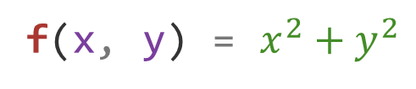

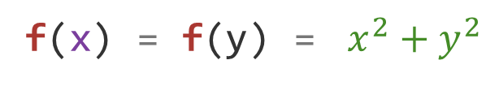
Currying Functional
f(x, y) = $x^{2}+y^{2}$
f(x) = ${\text{f}\text{(}\text{y}\text{)} \text{=} x}^{2}+y^{2}$
f(5, 2) = $5^{2}+2^{2}$
= 25 + 4
= 29
f(5) = f(y) = $5^{2}+y^{2}$
= f(2) = $5^{2}+2^{2}$
= 25 + 4
= 29

Slide 16
Currying Functional JavaScript
function add (a, b) {
return a + b;
}
add(3, 4); // returns 7
function add (a) {
return function (b) {
return a + b;
}
}
var add3 = add(3);
add3(4);

Slide 17
Currying Functional JavaScript(2)
multiply = (n, m) => (n * m)
multiply(3, 4) === 12 // true
curryedMultiply = (n) => ( (m) => multiply(n, m) )
triple = curryedMultiply(3)
triple(4) === 12 // true

Slide 18

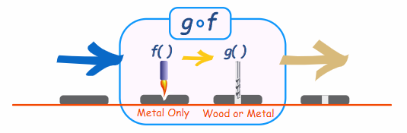


Compose Function
It is written: (g º f)(x)
Which means: g(f(x))
Example: f(x) = 2x+3 and g(x) = $x^{2}$

Slide 19
Compose Function Javascript
const compose = function(f, g) {
return function(x) {
return f(g(x))
}
}
const compose = (f, g) => x => f(g(x))

Slide 20
Compose Function Javascript(2)
We will create a function to clean the String before applying it. (Sanitize function)
Step
Cut off spaces in the front and back of the word.(trim)
Convert all words into lowercase.(toLowerCase)
function sanitize(str) {
return str.trim().toLowerCase()
}
sanitize(' Hello My Name is Ham ') // 'hello my name is ham'

Slide 21
Compose Function Javascript(3)
const trim = s => s.trim()
const toLowerCase = s => s.toLowerCase()
function sanitize(str) {
return toLowerCase(trim(str))
}
sanitize(' Hello My Name is Ham ') // 'hello my name is ham'
Analyze
const compose = (f, g) => x => f(g(x))
const sanitize = compose(toLowerCase, trim)
sanitize(' Hello My Name is Ham ')
// 'hello my name is ham'
toLowerCase = f
trim = g
str = x
toLowerCase(trim(str)) = f(g(x))
compose is function from lib !!!

Slide 22
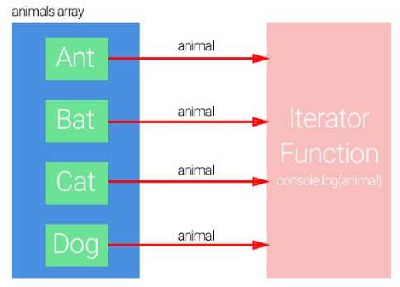
Array Method For Functional Programming
ForEach
const animals = ['Ant', 'Bat', 'Cat', 'Dog']
for (let i = 0; i < animals.length; i++) {
console.log(animals[i])
}
// Result : "Ant" "Bat" "Cat" "Dog"
const animals = ['Ant', 'Bat', 'Cat', 'Dog']
animals.forEach((animal) => {
console.log(animal)
})
// Result : "Ant" "Bat" "Cat" "Dog"

Slide 23
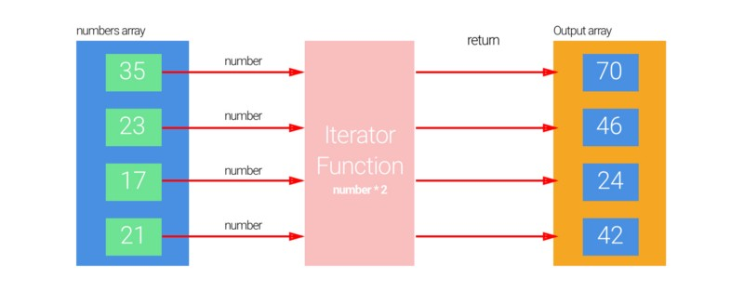
Array Method For Functional Programming
Map

Slide 24
Array Method For Functional Programming
Map
const numbers = [35, 23, 17, 21]
const result = numbers.map((number) => {
return number*2
})
console.log(result) // [70, 46, 24, 42]
const numbers = [35, 23, 17, 21]
let result = []
for (let i = 0; i < numbers.length; i++) {
result.push(numbers[i]*2)
}
console.log(result) // [70, 46, 34, 42]

Slide 25
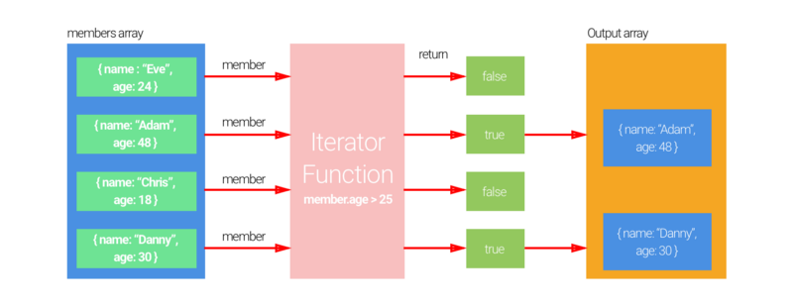
Array Method For Functional Programming
Filter

Slide 26
Array Method For Functional Programming
Filter
const members = [
{name: "Eve", age: 24},
{name: "Adam", age: 48},
{name: "Chris", age: 18},
{name: "Danny", age: 30}
]
let result = []
for (let i = 0; i < members.length; i++) {
if (members[i].age > 25) {
result.push(members[i])
}
}
console.log(result)
// [{name: "Adam", age: 48}
, {name: "Danny", age: 30}]
const members = [
{name: "Eve", age: 24},
{name: "Adam", age: 48},
{name: "Chris", age: 18},
{name: "Danny", age: 30}
]
const result = members.filter((member) => {
return member.age > 25
})
console.log(result)
// [{name: "Adam", age: 48}
, {name: "Danny", age: 30}]

Slide 27
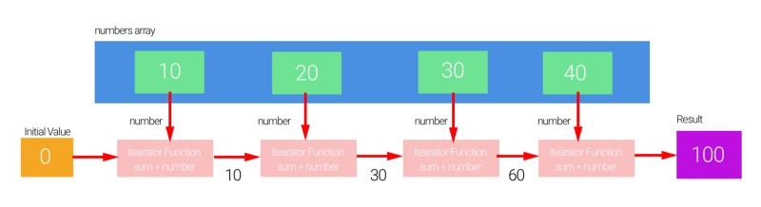
Array Method For Functional Programming
Reduce

Slide 28
Array Method For Functional Programming
Reduce
const numbers = [10, 20, 30, 40]
const result = numbers.reduce((sum,number) => {
return sum+number
}, 0)
console.log(result) // 100
const numbers = [10, 20, 30, 40]
let result = 0
for (let i = 0; i < numbers.length; i++) {
result += numbers[i]
}
console.log(result) // 100

Slide 29


Slide 30

Array Method For Functional Programming
xxx

Slide 31


Slide 32
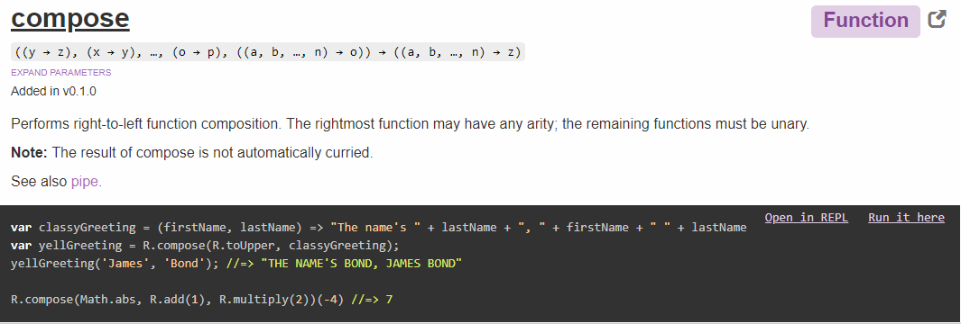

Slide 33
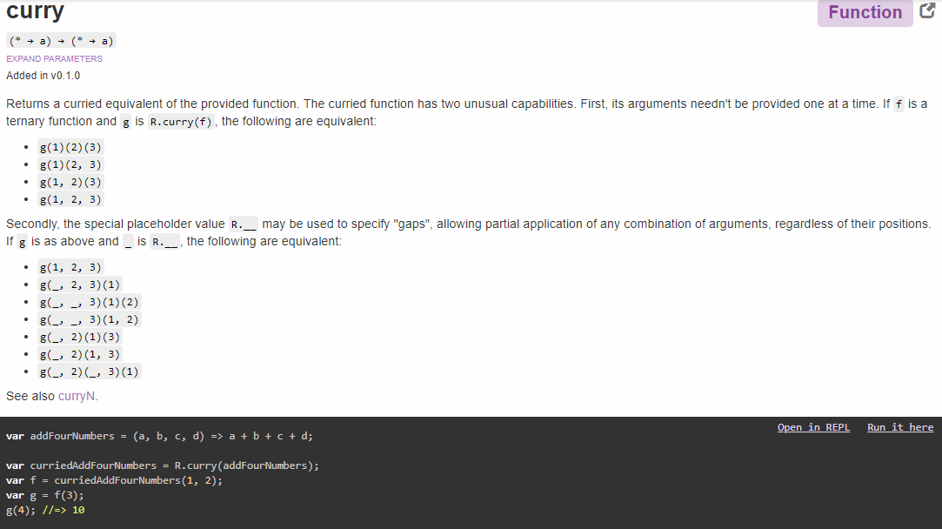

Slide 34
Reference
http://ramdajs.com/docs/#curry
http://ramdajs.com/docs/#compose
Learning React: Functional Web Development with React and Redux 1st Edition, Kindle Edition

